Slide 1
Unit 7 For Live Session Assignment
Isabella Westlauer
2/15/2026

Slide 2
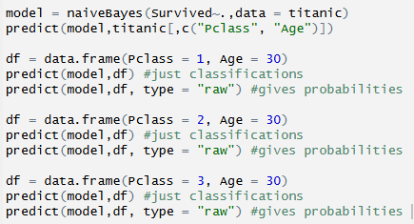
Prediction Using Naïve Bayes Model
Pclass | 0 (Died) | 1 (Survived)
1 | 0.2953416 | 0.7046584
2 | 0.6063917 | 0.3936083
3 | 0.7735716 | 0.2264284
Likelihood of survival for a passenger age 30 aboard the Titanic, in various passenger classes (Pclass)
Notes:
In the last unit you used a KNN classifier to classify the passengers who survived and died. Now we will use a Naïve Bayes (NB) classifier and compare the two!
Using all 891 observations, train a NB model with Age and Pclass as predictors and use this model to predict the survival of a 30 year old passenger in the 1, 2 and 3 classes. Use the “type = raw” option to look at the predicted percentage of each outcome. (One slide.)

Slide 3
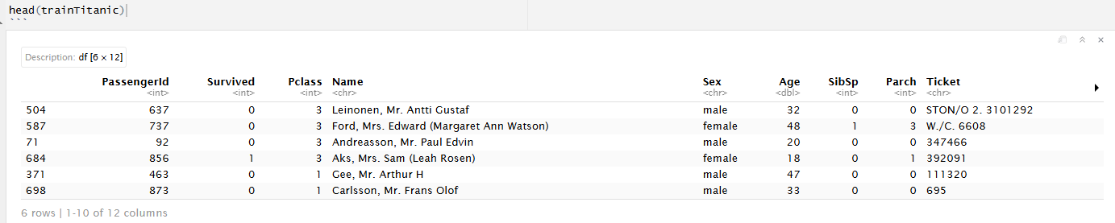
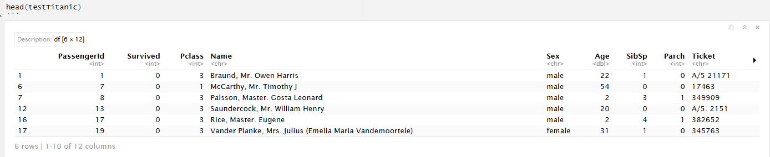
Train Set and Test Set
After filtering out rows with NA Age or Pclass, the titanic data set was partitioned into a training set and a test set using a seed of 4. Here’s a peek at each one.
Training Set: 70%
Test Set: 30%
Notes:
Split the 891 observations into a training and test set 70% - 30% using this seed and code:
titanicClean = titanic %>% filter(!is.na(Age) & !is.na(Pclass))
set.seed(4)
trainIndices = sample(seq(1:length(titanicClean$Age)),round(.7*length(titanicClean$Age)))
trainTitanic = titanicClean[trainIndices,]
testTitanic = titanicClean[-trainIndices,]
(One slide that shows the head of trainTitanic and testTitanic)

Slide 4
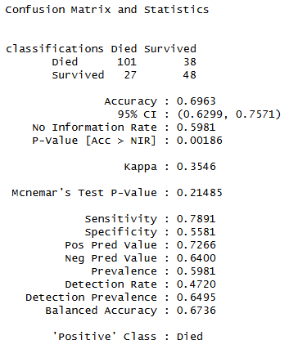
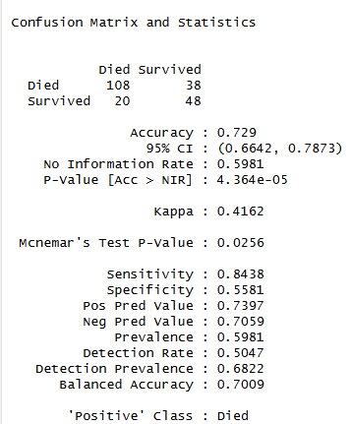

Comparison of KNN and Naïve Bayes Models
Seed(4)
How does the Naïve Bayes model compare to the knn model (k=3)? Accuracy: increased
Sensitivity: increased
Specificity: unchanged
KNN: k=3
Naïve Bayes: seed(4)
Notes:
Train a NB model based on the training set using just the Age and Pclass variables. Use the model to predict the survival of those in the test set and use those results to evaluate the model based on accuracy, sensitivity and specificity. Finally, Compare the results to what you found with the KNN classifier. (At least one slide.)

Slide 5
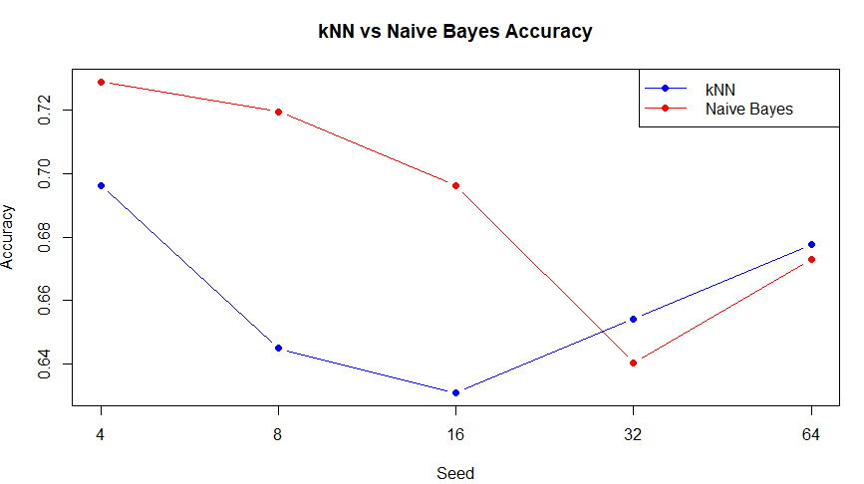
Comparison of KNN to NB with 5 different seeds
KNN/NB | Accuracy | Sensitivity | Specificity
Seed = 4 | 0.6963/0.729 | 0.7891/0.8438 | 0.5581/0.5581
Seed = 8 | 0.6449/0.7196 | 0.7214/0.8500 | 0.5000/0.4730
Seed = 16 | 0.6308/0.6963 | 0.7266/0.8281 | 0.4884/0.5000
Seed = 32 | 0.6542/0.6402 | 0.7323/0.8189 | 0.5402/0.3793
Seed = 64 | 0.6776/0.6729 | 0.7634/0.8092 | 0.5422/0.4578
In 5 out of 5 seed comparisons, the sensitivity of the NB model was higher than that of the KNN model. It’s not clear if the difference in accuracy is significant between the models or between the seeds. Why is the sensitivity better than the specificity in all these cases, regardless of the model or the seed? Is that because the positive class “Died” represents most of the observations in the training set?
Notes:
Now repeat the above with a new seed and compare the accuracy, sensitivity and specificity. Do this 3 or 4 times to observe the variance in the statistics. (At least one slide.)

Slide 6
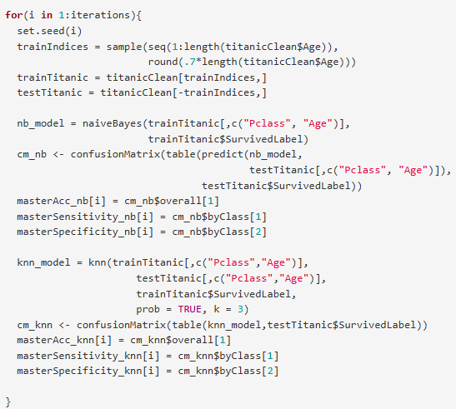
Average the Model Evaluations for 100 Seeds
 | Accuracy | Sensitivity | Specificity
KNN | 0.6628972 | 0.7781763 | 0.499643
NB | 0.6900467 | 0.8495778 | 0.4617856
On average, the accuracy and sensitivity of the NB model are a little bit higher. It’s unclear why the specificity is low for both models, or why it would be higher for the KNN. Is there an inverse relationship between sensitivity and specificity?
Sensitivity: Number of correctly identified deaths/true number of deaths
Specificity: Number of correctly identified survivals/true number of survivals
Notes:
Write a loop to repeat the above for 100 different values of the seed. Find the average of the accuracy, sensitivity and specificity to get a stable (smaller variance) statistic to evaluate the model. (At least one slide.)

Slide 7
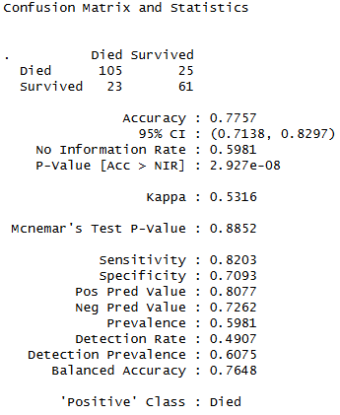






Introducing another explanatory variable
The accuracy and specificity are higher with three explanatory variables than with two, for the same seed (4). However, the sensitivity is lower. What does this mean?
Based on Age, Pclass
Based on Age, Pclass, and Sex
Notes:
Now add Sex to the model so that it has Age, Pclass and Sex in the NB model. Use the trainTitanic(set.seed(4)) dataframe to train the model and create a confusion matrix using the testTitanic dataframe. In addition, find the Accuracy, Sensitivity and Specificity. (1 slide)

Slide 8
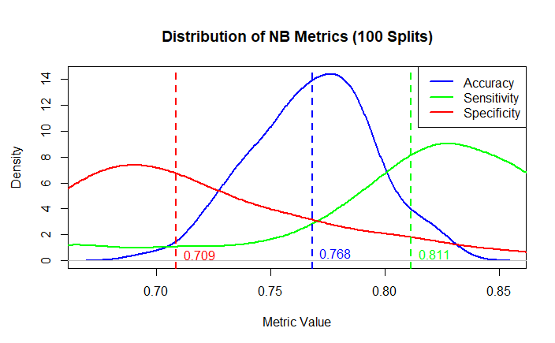
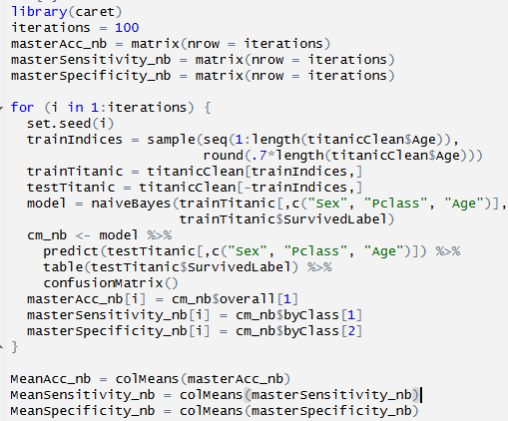
Stable Estimate of NB Model Performance
The distribution of the sensitivity and the distribution of the specificity are asymmetrical because of the imbalance between the number of positive (Died) and negative (Survived) observations in the training set.
Notes:
Again write a loop to get a stable estimate of the accuracy, sensitivity and specificity of this model (using 100 unique seeds). (1 slide)
BONUS: Using the Male and Female KNN from the bonus of Unit 6, combine the two confusion matrices from the Male and Female KNN models to make one confusion matrix and find the accuracy, sensitivity and specificity based on that model. Compare this with the performance of your NB model. Do you prefer one over the other?

Slide 9
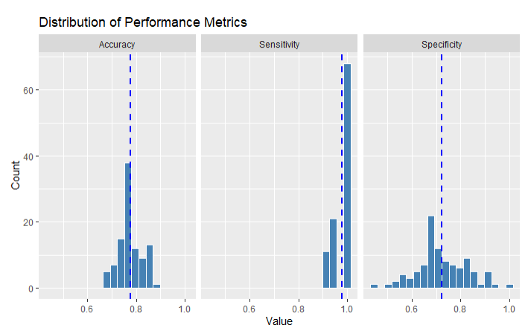
Iris Cross Validation NB vs KNN Models
The chart shows the distribution of performance metrics for the NB model, over 100 different 70-30 train/test splits. The species was classified based on the sepal length and width. In Unit 6, I measured the accuracy of a KNN model over 500 iterations of 90 different k values. Over all 4500 accuracies, the mean was 0.7358879 (less than the accuracy for NB).
0.7753333
0.9779298
0.7227796
Notes:
a. For the full (multinomial) IRIS data (the iris dataset in R), do a 70-30 train/test cross validation and use sepal length and width as predictors. Generate 100 different train/test splits and calculate the average accuracy, sensitivity and specificity. Compare the average accuracy to that to the KNN model you used in Unit 6.

Slide 10
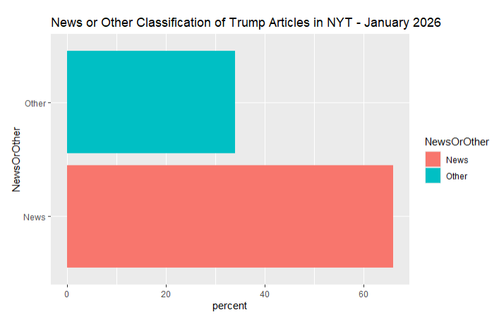
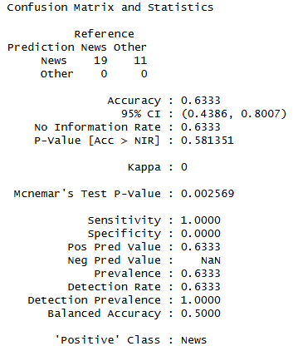
NYT News/Other Classifier
The specificity of 0 means that the model isn’t good at classifying any articles as “Other” based on the training data. It predicted all these headlines were “News”.
The graph shows the media type of the articles from the NYT query – the actual classifications are about 65% News and 35% Other.
198 results for Trump in January 2026 here: (only 100 results fetched before API connection error)* https://api.nytimes.com/svc/search/v2/articlesearch.json?q=Trump&begin_date=20260101&end_date=20260131&facet_filter=true&api-key=DYY6iHutIPXhgaCBy6Dj8NE6n9PSphPQi6loyuYWL3z6mbLG *see Takeaways and Questions for the explanation
Notes:
Use the NYT News/Other Classifier code to analyze stories about Trump last month (search term “Trump”).
We would like to build a classifier that will classify between news stories and other and we would like to compare two models:
one that uses the headline and one that uses the snippet.
Compare these two models based on sensitivity and specificity and provide at least one plot to help you visualize the results.

Slide 11
NYT News/Other Classifier
I replaced headline.main in the function and in the for loop, but the results looked the same in the confusion matrix.
All 30 articles in the test set were predicted to be News, whether based on the headline or the snippet.
This tells me the model isn’t useful for classifying the “other” articles.
Notes:
Use the NYT News/Other Classifier code to analyze stories about Trump last month (search term “Trump”).
We would like to build a classifier that will classify between news stories and other and we would like to compare two models:
one that uses the headline and one that uses the snippet.
Compare these two models based on sensitivity and specificity and provide at least one plot to help you visualize the results.

Slide 12
NYT News/Other Classifier
Insert visualization comparing the headline classification to the snippet classification… why were none of the articles classified as other?
Why are there Interactive articles about the souper bowl that may not have anything to do with Trump?

Slide 13
Takeaways and Questions
If the model has a higher sensitivity than specificity, does that mean it’s better at classifying positives than negatives? Do we want to optimize a model by getting the highest accuracy, sensitivity, and specificity? Is there always a tradeoff between sensitivity and specificity?
How do data scientists keep up with changes such as the NYT API rate limit changing to 5 requests per minute compared to 10 per minute a few years ago? Just discover it through trial and error?
While querying the NYT API, I ran into a connection error after 100 pages, so I used a try(…, silent = TRUE), but then I only got 100 pages successfully and found this: * “Pagination--https://developer.nytimes.com/docs/articlesearch-product/1/overview
The Article Search API returns a max of 10 results at a time. The meta node in the response contains the total number of matches ("hits") and the current offset. Use the page query parameter to paginate thru results (page=0 for results 1-10, page=1 for 11-20, ...). You can paginate thru up to 100 pages (1,000 results). If you get too many results try filtering by date range. Hits shows 10,000 if there are 10,000 or more results.”
So, how can I get all 198 pages of results?
In the NYT Article classification problem, why did the results not change when I ran the classification again for snippet rather than headline.main?

Slide 14
